Slide 1
Masters Project
Professor: Dr. Thiago E. A. de Oliveira
Student: YiDong Huang, Devansh Mody

Slide 2

Hate Speech Detection

Slide 3
Agenda
Abstract
Introduction
Literature Review
Researcher’s Approach
Results
Common Challenges/Limitations
Our Approach/Methodology
Discussion
Conclusion

Slide 4
Abstract
Hate Speech in social media is a complex phenomenon.
Due to the massive rise of user generated web content on social media, the amount of hate speech is also steadily increasing.
Detecting hate speech has gained attention in the Natural Language Processing community.
Our goal is to identify given a text weather it's an hate speech or not.

Slide 5


Introduction
Social media
Print media

Slide 6
Introduction
Hate speech is one that is intended not just to insult or mock, but to harass and cause lasting pain by attacking something uniquely dear to the target.
Over the past years, interest in online hate speech detection and, particularly, the automation of this task has continuously grown, along with the societal impact of the phenomenon.
This hate speech introduces bias in dataset when performing analysis of reviews or summarizing news articles or reviews.
Detecting hate speech is a classification problem.

Slide 7
Three of the most important papers out of all the papers referred
Thomas Davidson, Dana Warmsley, Michael Macy and Ingmar Weber, "Automated Hate Speech Detection and the Problem of Offensive Language", arXiv:1703.04009v1 [cs.CL] 11 Mar 2017. (number of citations 610)
Size of the dataset consisted of 24,802 samples.
Mathew B, Saha P, Yimam S, Biemann C, Goyal P and Mukherjee A, "HateXplain: A Benchmark Dataset for Explainable Hate Speech Detection", ArXiv: 2012.10289 18 Dec 2020. (latest research work done in this area)
Size of the dataset consisted of 20 thousand samples
Marcos Zampieri, Shervin Malmasi, Preslav Nakov, Sara Rosenthal, Noura Farra and Ritesh Kumar, "Predicting the Type and Target of Offensive Posts in Social Media", Proceedings of NAACL-HLT 2019. (number of citations 127)
Offensive Language Identification Dataset (OLID) created from twitter tweets.Offensive Language Identification Dataset (OLID)

Slide 8
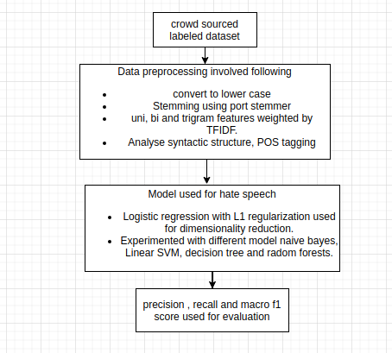
Thomas davidson, et al. approach
￼

Slide 9
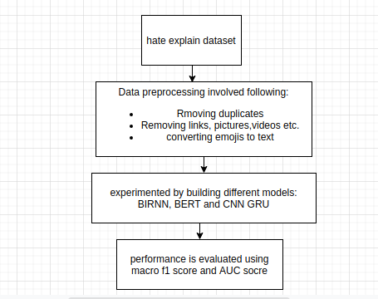
Mathew B, et al. approach

Slide 10
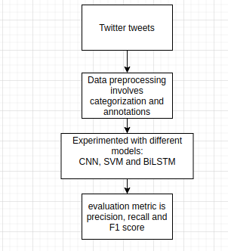
Marcos Zampieri, et al. approach

Slide 11
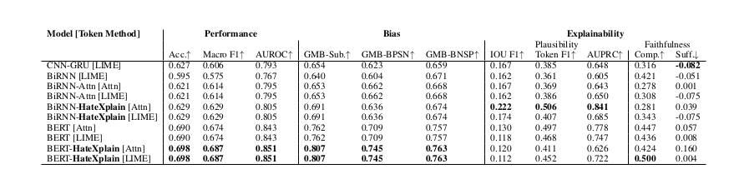
Results achieved by researchers
The best performing model has an overall precision 0.91, recall of 0.90, and F1 score of 0.90. (Thomas davidson, et al.)
Below screenshot is from the research done by (Mathew B, et al. )

Slide 12
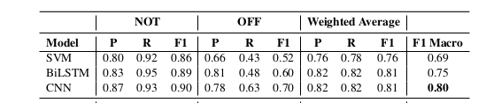
Results achieved by researchers
Below screenshot is from the research done by (Marcos Zampieri, et al.)

Slide 13
Common problems faced by researchers
Lack of external context such as profile bio, user gender, history of posts etc., which might be helpful in the classification task.
Building a multi language model.
Context analysis and subjective analysis .
These are few of the limitations or challenges faced by the authors during their research work.

Slide 14
Papers referred
Davidson, T., Warmsley, D., Macy, M. and Weber, I., 2017. Automated Hate Speech Detection and the Problem of Offensive Language
Size of dataset: 24,802
Gao, L. and Huang, R., 2017. Detecting Online Hate Speech Using Context Aware Models
Size of dataset: 1528
Zampieri, M., Malmasi, S., Nakov, P., Rosenthal, S., Farra, N. and Kumar, R., 2019. SemEval-2019 Task 6: Identifying and Categorizing Offensive Language in Social Media (OffensEval).
Size of dataset: 14,100
Ousidhoum, N., Lin, Z., Zhang, H., Song, Y. and Yeung, D., 2019. Multilingual and Multi-Aspect Hate Speech Analysis.
Size of dataset: 4,014
Qian, J., Bethke, A., Belding, E. and Yang Wang, W., 2019. A Benchmark Dataset for Learning to Intervene in Online Hate Speech.
Size of dataset: 33,776
Gomez, R., Gibert, J., Gomez, L. and Karatzas, D., 2019. Exploring Hate Speech Detection in Multimodal Publications.
Size of dataset: 149,823
Basile, V., Bosco, C., Fersini, E., Nozza, D., Patti, V., Pardo, F., Rosso, P. and Sanguinetti, M., 2019. SemEval-2019 Task 5: Multilingual Detection of Hate Speech Against Immigrants and Women in Twitter.
Size of dataset: 13,000

Slide 15
Papers referred
Mandl, T., Modha, S., Majumder, P., Patel, D., Dave, M., Mandlia, C. and Patel, A., 2019. Overview of the HASOC track at FIRE 2019. In: Proceedings of the 11th Forum for Information Retrieval Evaluation,.
Size of dataset: 7,005
de Gibert, O., Perez, N., García-Pablos, A., and Cuadros, M., 2018. Hate Speech Dataset from a White Supremacy Forum. In: Proceedings of the 2nd Workshop on Abusive Language Online (ALW2).
Size of dataset: 9,916
Waseem, Z. and Horvy, D., 2016. Hateful Symbols or Hateful People? Predictive Features for Hate Speech Detection on Twitter.
Size of dataset: 16,914
Fersini, E., Rosso, P. and Anzovino, M., 2018. Overview of the Task on Automatic Misogyny Identification at IberEval 2018.
Size of dataset: 3,977
ElSherief, M., Nilizadeh, S., Nguyen, D., Vigna, G. and Belding, E., 2018. Peer to Peer Hate: Hate Speech Instigators and Their Targets.
Size of dataset: 27,330

Slide 16
Methodology used by researchers in their work
LSTM networks and BERT is used for classification and Macro-F1 score is used as evaluation metric (HASOC)
Extracted uni,bi and trigrams, Pos tagging, sentiment scores based on (Hutto)
and Gilbert 2014), logistic regression with L1 to reduce dimensionality then classifiers like naive bayes, svm and others. (davidson)
Word level, character level, Linguistic Inquiry and Word Count (LIWC) and NRC Emotion Lexicon features, then a neural network model using LSTM with Attention mechanism is used for classification. (Lei Gao)
Applied BiLSTM, SVM and CNN on labeled data out of three CNN performed the best. (Marcos Zampieri)
Babylon embeddings with one hidden layer BiLSTM model. (Nedjma Ousidhoum)
CNN model is compared with RNN which uses generative hate speech intervention with seq2seq and variational autoencoder additionally reinforcement learning is applied on seq2seq model to generate backward probability and train the model. Evaluation metric used BLEU, ROUGE-L and METEOR score.(Jing Qian)
Mixture of text based and image based model is used, Google Vision API Text Detection module is used to detect text in image then LSTM model is used for classification. (Raul Gomez)
Hate speech detection was divided in two tasks in first task POS tagging, finding n-grams, removing stopwords was done then basic naive bayes models using TF IDF to generate vectors was used, for second task lexical and syntactic features were trained on a LSTM model for detecting hate speech.

Slide 17
Our Approach
The approach to design the model and various steps which can be incorporated and new techniques and addition of modules to improve hate speech detection.
Replacing short word with their longer forms also known as contractions e.g. I’ve replacing with I have.
Removing stopwords, Normalizing text.
Using Conceptual number batch word embeddings (One of the best embeddings this is new and we will use this embeddings), additionally we will use character based embeddings for single characters.
Using attention mechanism transformer based approach for sentiment analysis and classification.
Also a pretrained model like GPT-2 and Latest BERT model by google can be used and its embedding layer can be replaced with our conceptual net layer and training from scratch can be carried out.
For evaluating the performance Macro-F1 score, Rouge-L score and BLEAU score can be used.
This is our future plan for hate speech detection project.
Also sentence similarity matching will be used for our project.
Different decoding strategies like temperature, topK and nucleus based methods hat can used to understand the output of model
LIME library will be used for interpreting the output of the model.
Additionally, we can build a voting model.

Slide 18
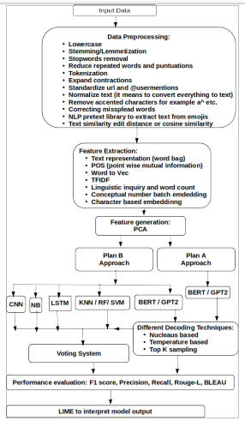
Results: Evaluating the performance using F1 score, Precision, Recall, Rouge-L, BLEAU and using LIME for interpreting the model output.
Figure:- Flow diagram of our approach

Slide 19
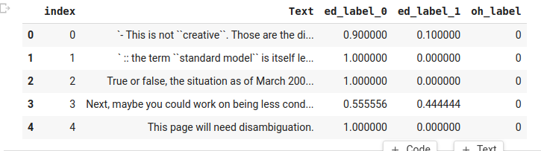
Datasets
Size of data set is approximately 300 MB with more than a 300 thousand samples.
Additionally more data can be consolidated and size can be increased for detection of hate speech.
This is a classification problem.
This website https://hatespeechdata.com/ contains huge amount of the data for the work also there is lot of labeled data available on kaggle for the research work.
Below given is the snapshot of the dataset.

Slide 20
Conclusion
Henceforth we would like to carry out an voluminous research analysis to detect hate speech in text by understanding the sentiment and the context of a text, tweet and other short sentences. Furthermore numerous patterns in text data needs to be explored to understand and decode hate speech. Additionally also our project can be used as a preprocessing step to remove biases like hate speech before developing other projects like text summarization, text generation and other projects.

Slide 21
Thank You

